Slide 1
The Music Cube
Assignment 3 Prototype Draft

Slide 2
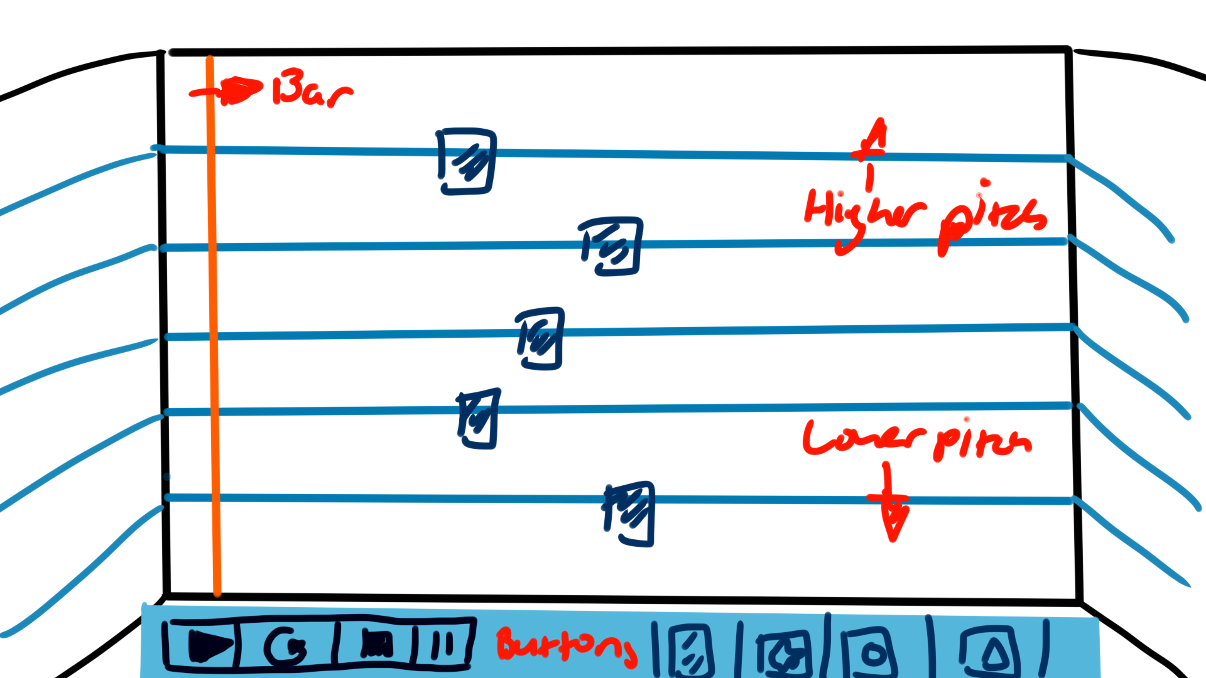

Slide 3
Code
Live Input
Record your own voice / sound and store it into own object
Insert own sound effect from mp3 or wav file
Shortcut keys such as space bar to pause / play
Mouse input. Clicks and drags sliders to adjust speed / gain
Using Processing
Requires ArrayList to store shapes / images and the audio files
Will need to use dist function to determine mouse placement and which face of cube user is on
Using Beads libraries

